Slide 1

Control Systems Lab
Presentation
Inverted Double Pendulum
Cirillo Matteo 5616395
Van der Spijk Tim 4693817
Laporte Lilian 5615208

Slide 2
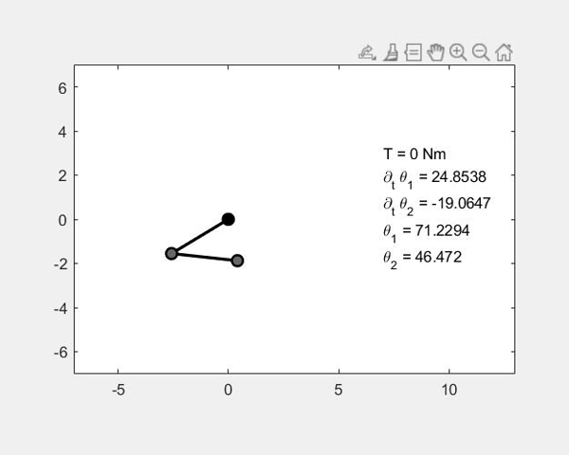
Outline
Modelling
Full Non Linear Model
State Space Linearization
Identification
Interfacing
Nonlinear White Box model
Linear Black box model
Linear Control
LQR Regulator
PID Controller

Slide 3
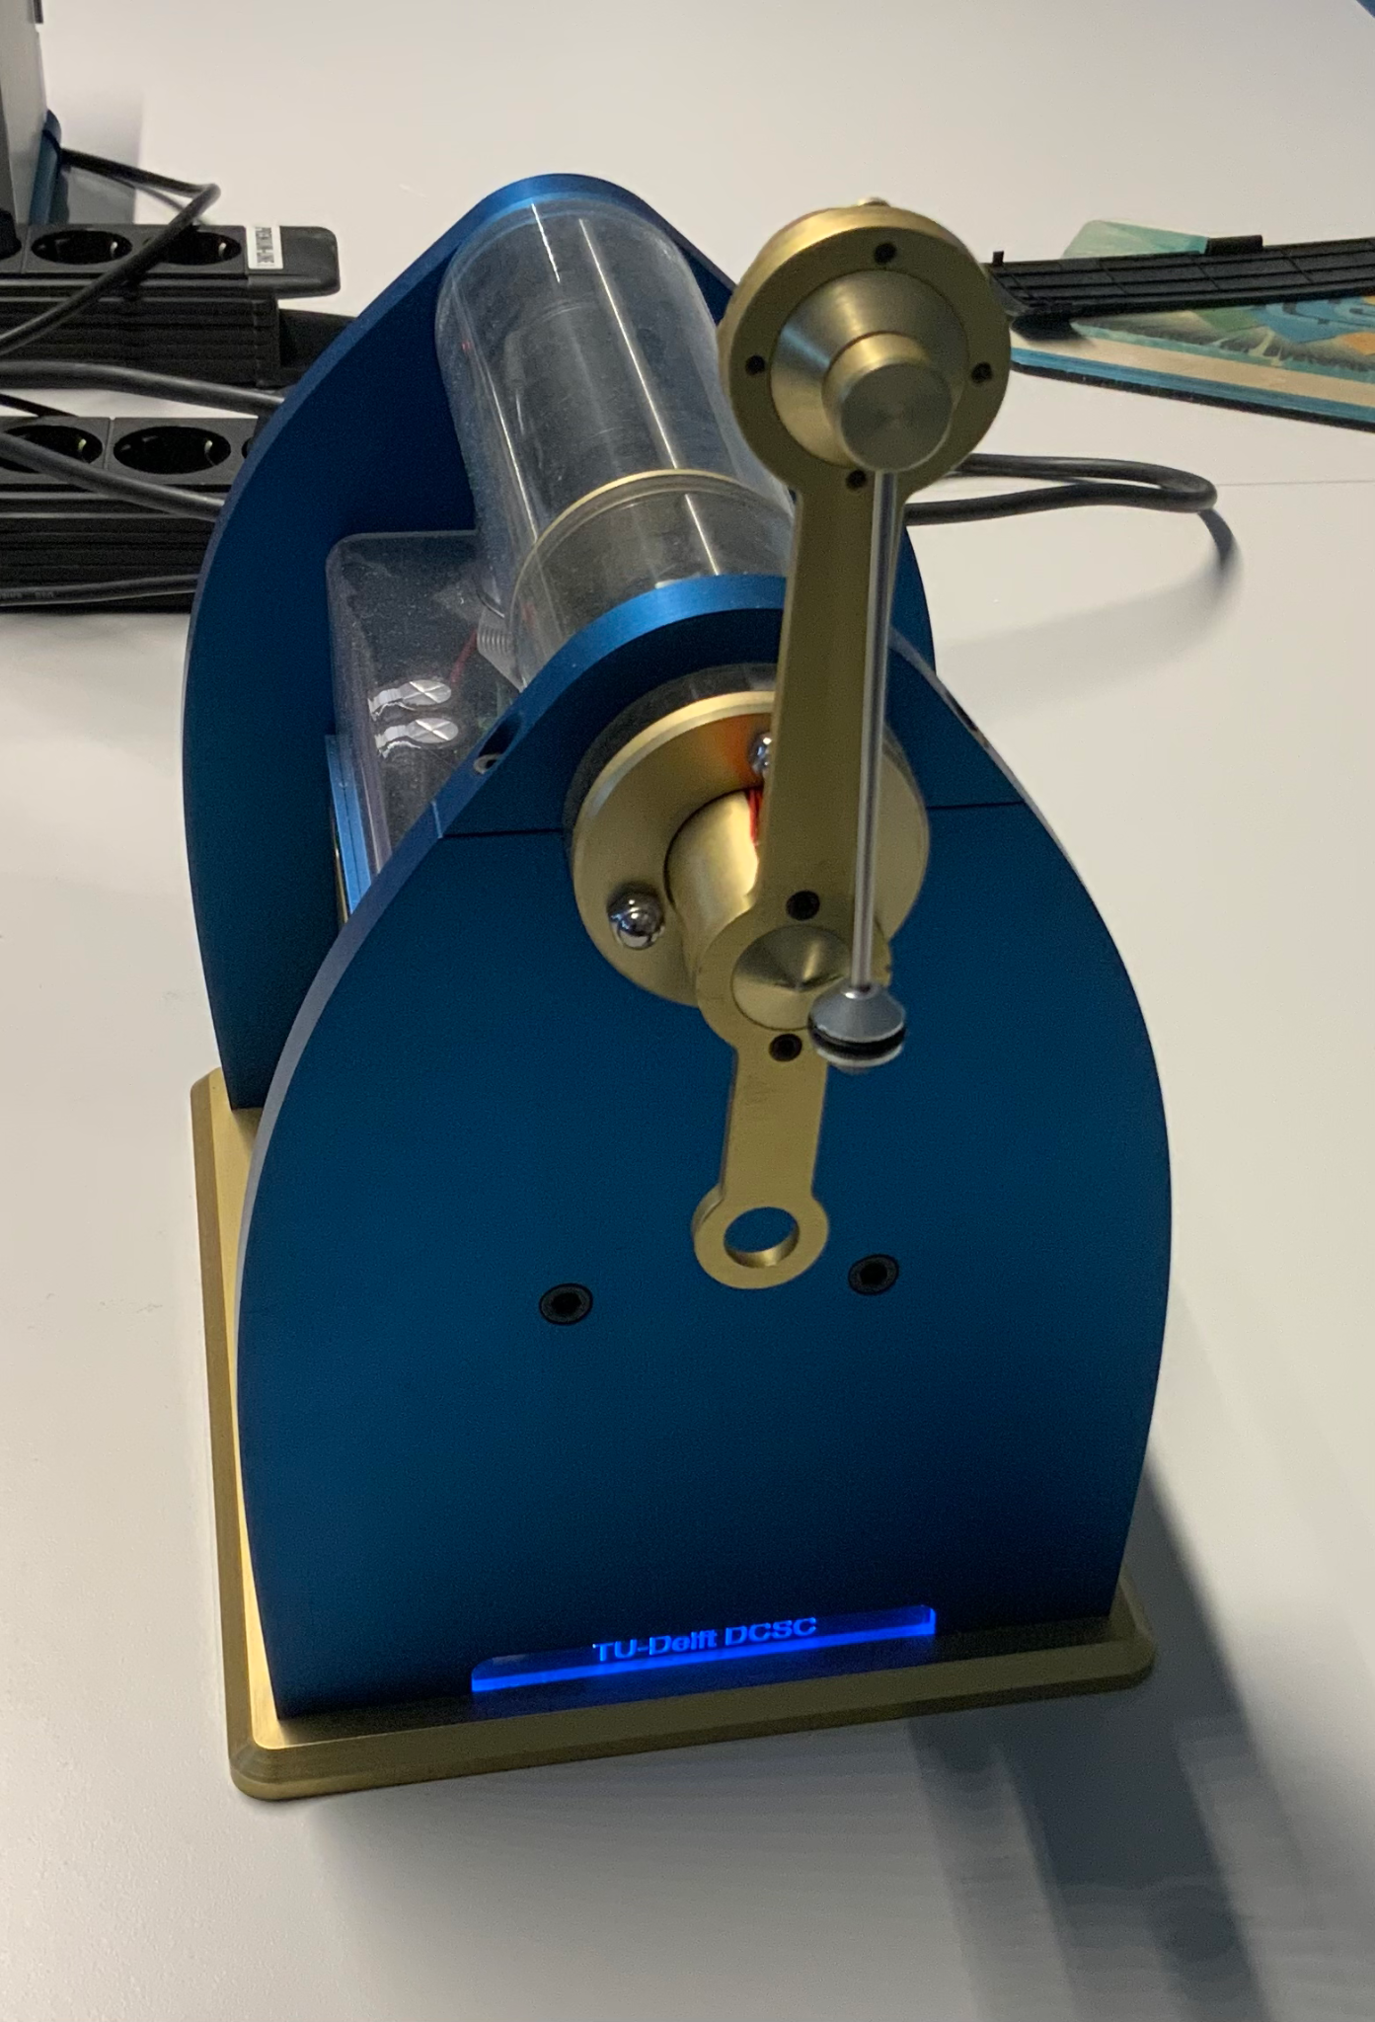
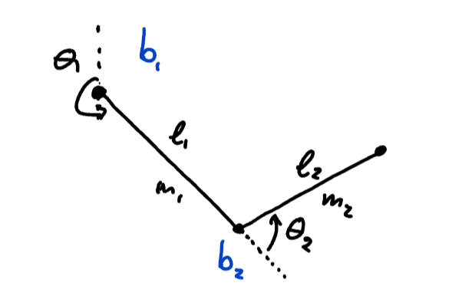
Plant - Inverted Double Pendulum

Slide 4
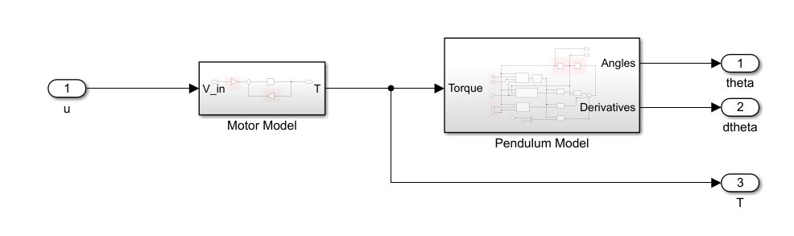
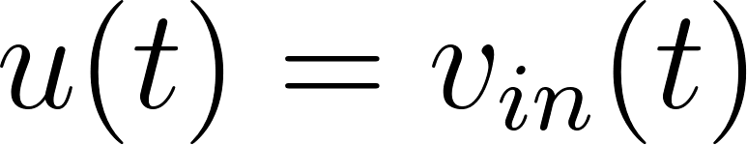
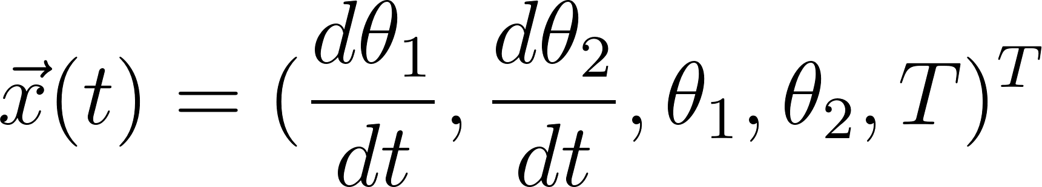
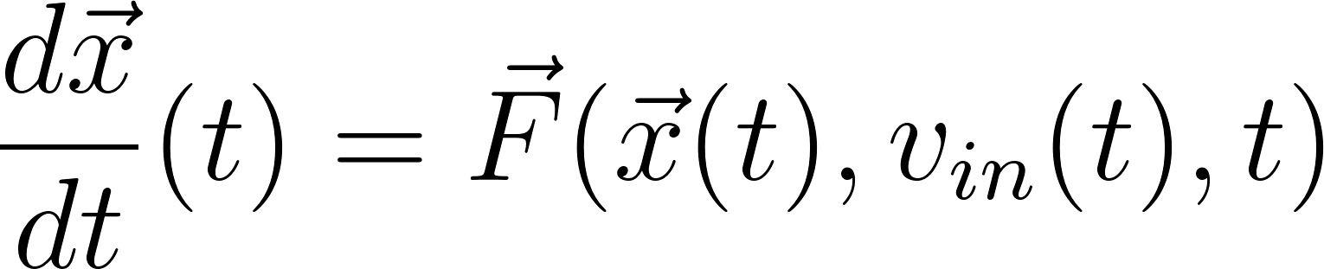
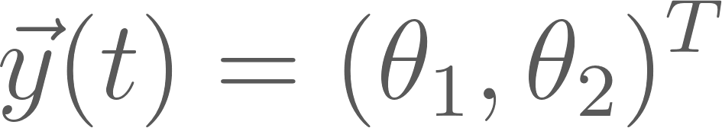
Modelling - Ideal Nonlinear SIMO Model
Single Input
Chosen State (5th order system)
Available Outputs
=
Notes:
LILIAN
IDEAL model
Outputs = WHAT’s available

Slide 5
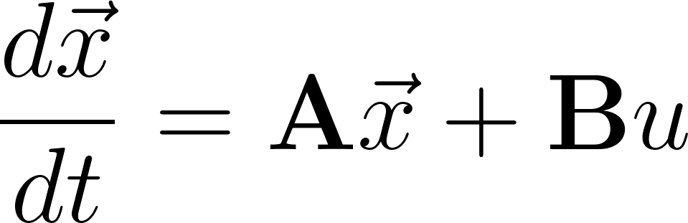
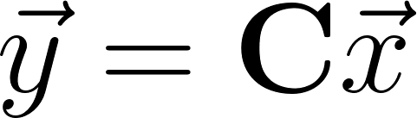
Modelling - Linearization
Matlab Manual Symbolic Linearization
Longer implementation
Longer execution
More control (Educational)
Final State Space
Continuous Time
Notes:
Symbolic vs numeric

Slide 6
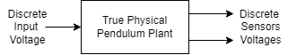
Identification - Interfacing
Sampling Period
h ~ Fastest Dynamic / 2 ~ 𝜏_{e} / 2
Design in CT
Sensor Calibration
Notes:
REALITY != IDEAL
h = 5ms

Slide 7
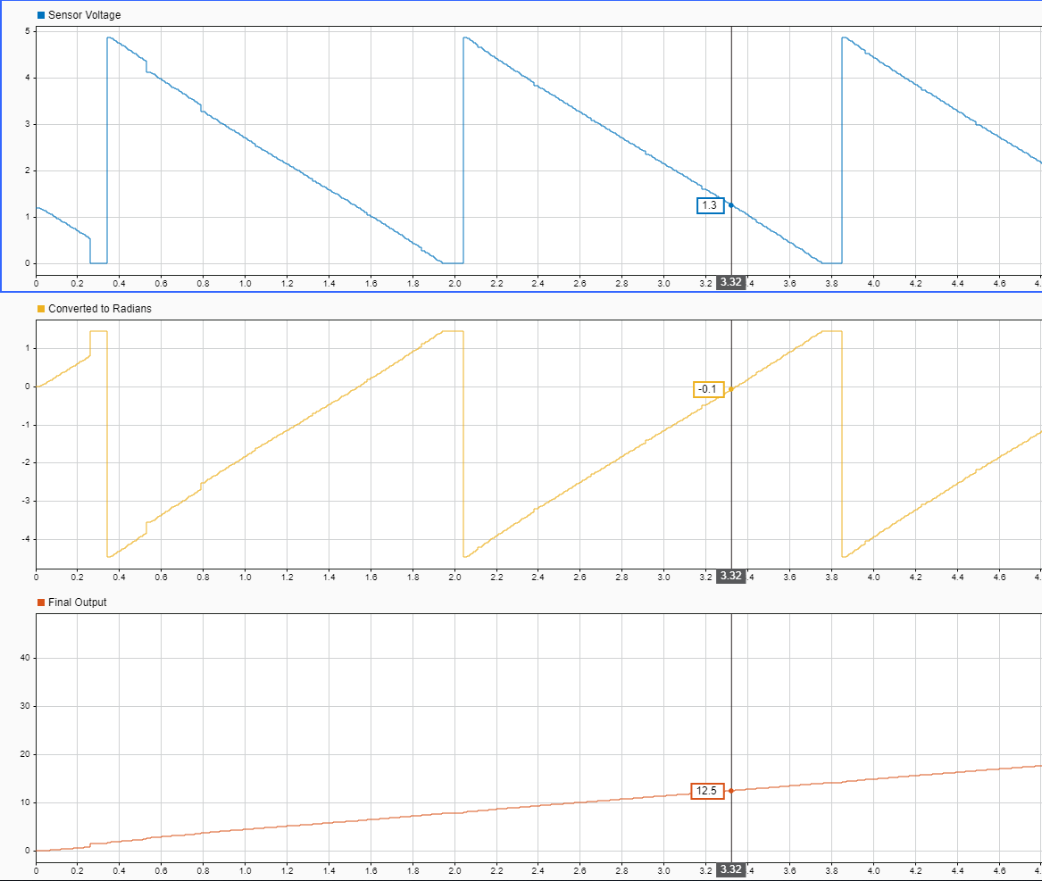
Probed Sensor Voltage
Converted in Radians
Unwrapped Measurement

Slide 8
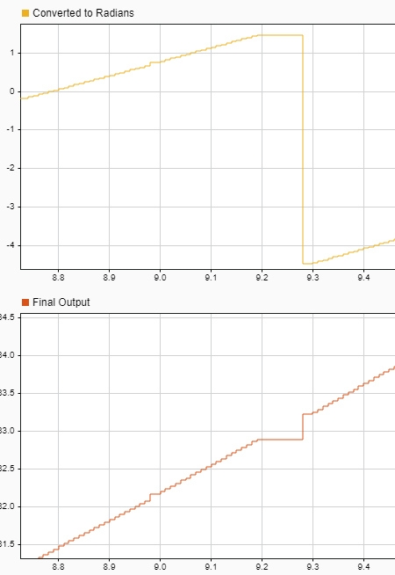
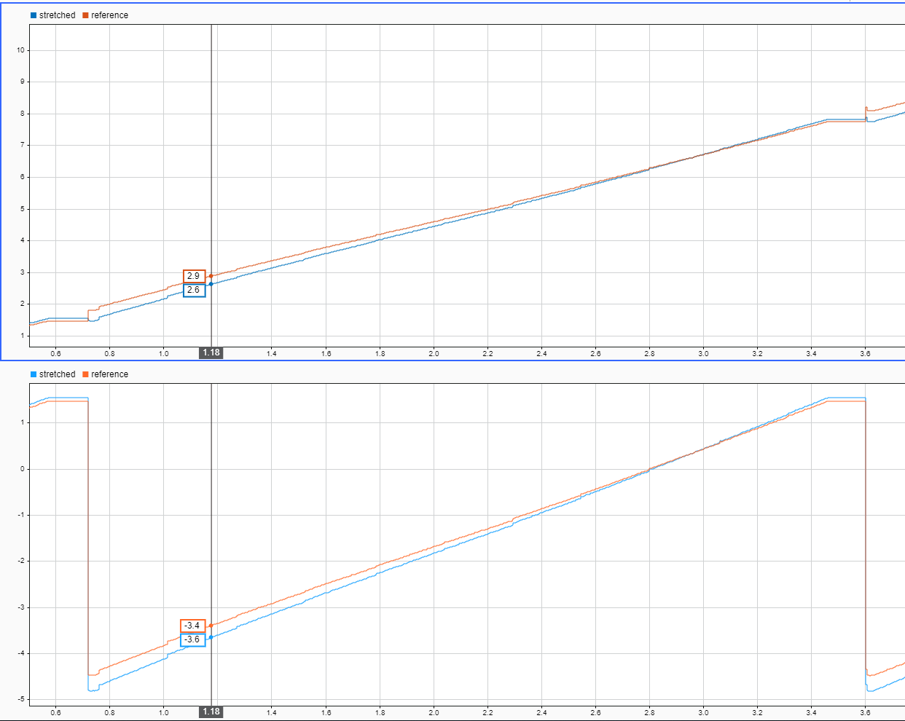
Dead-zones / Compensation
Dead-zones
~5% range loss
At pi/4 for both links
Range Stretching
Reduces discontinuity
Spreads error

Slide 9
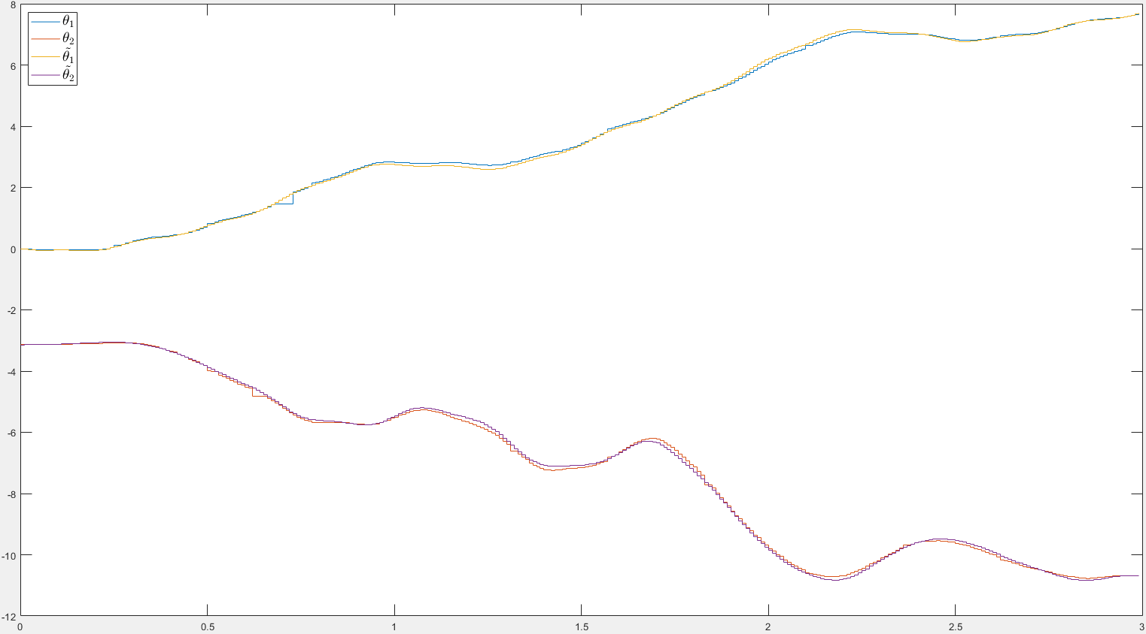
Identification - Nonlinear White Box model
Method
Simdata
lsqnonlin
Experiments
Second link
Motor
First link
Troubles
Notes:
Lilian

Slide 10
Identification - Nonlinear White Box model
Symbol | Predetermined | Estimated
l1 [m] | 0.1 | 0.0897
l2 [m] | 0.1 | 0.1
m1 [kg] | 0.125 | 0.2
m2 [kg] | 0.05 | 0.087972
c1 [m] | -0.04 | 0.01
c2 [m] | 0.06 | 0.07
I1 [kg.m²] | 0.074 | 0.01076
I2 [kg.m²] | 0.00012 | 0.0001
b1 [kg.s⁻¹] | 4.8 | 5.33518
b2 [kg.s⁻¹] | 0.0002 | 0.00004
k_{m} [Nm] | 50 | 39.2954
𝜏_{e} [s] | 0.03 | 0.01

Slide 11
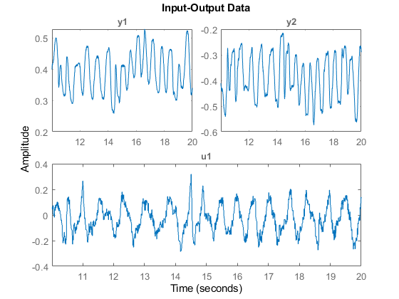
Identification - Linear Black box model
ARX linear discrete time model
Data set: up - up position
Not used in practice
Educational
Notes:
TIM

Slide 12
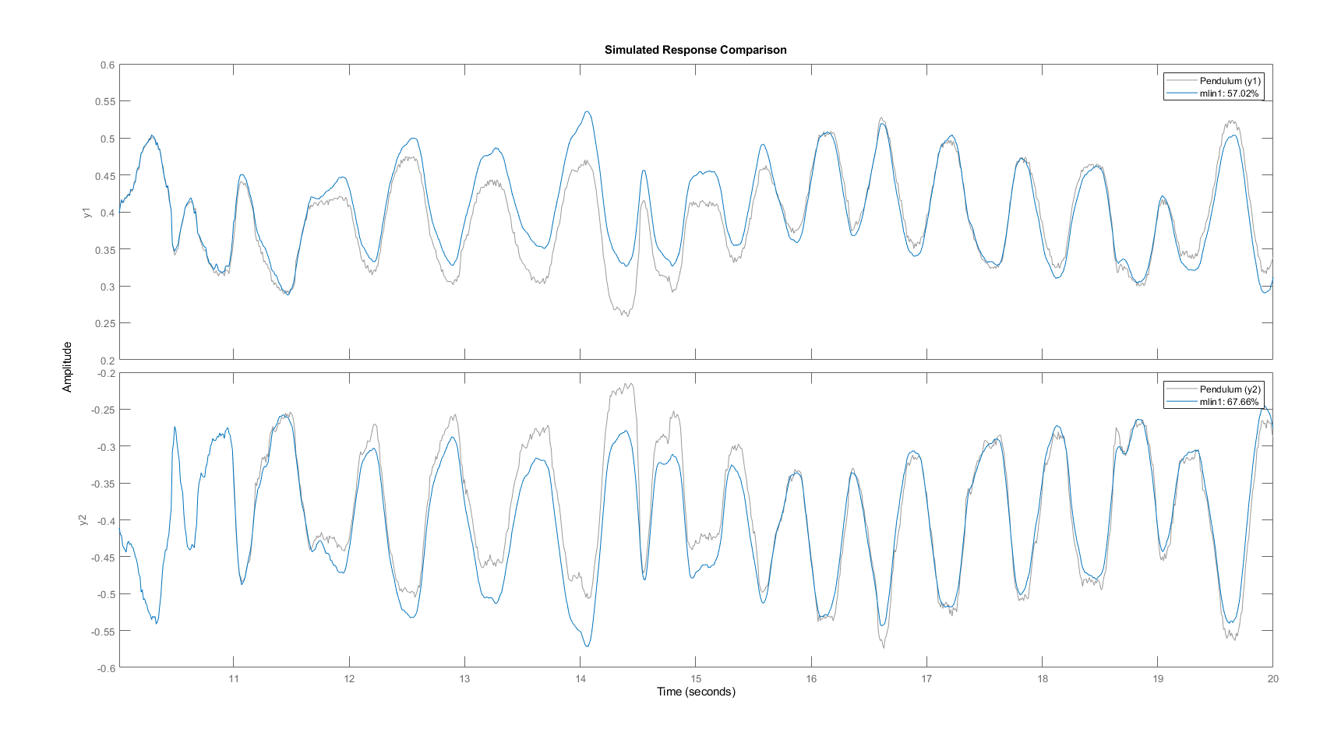

Slide 13
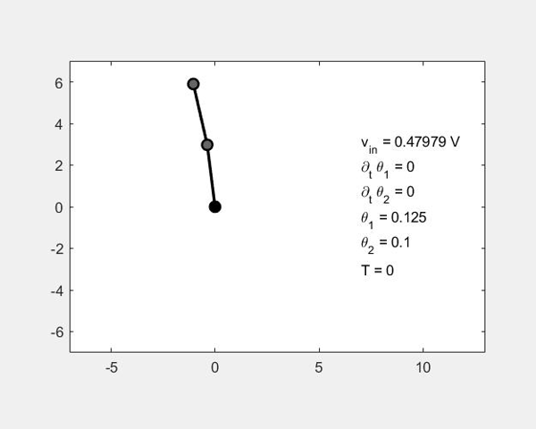
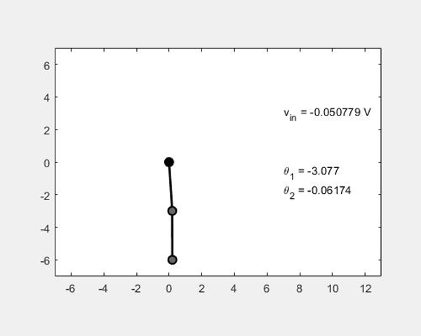
Linear Control - Objectives
Up up position
Equilibrium Stabilization
Down Down position
Input Disturbance Rejection
Motivation for objectives
Intuition
Simulation ‘eig(ctrb(A, B))’
Notes:
SAY HOW TRIED TO DO OTHER POSITIONS

Slide 14
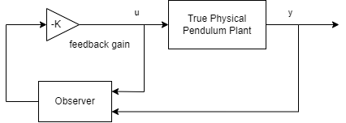
Up Up Position - LQR Regulator
Motivation w.r.t Objective
Easy pole placement
Combined Layout
Luenberg Observer
Output Feedback
Design
Decoupling of the eigenvalues
Feedback first, observe faster
Notes:
Easy pole placement for STABILIZATION

Slide 15
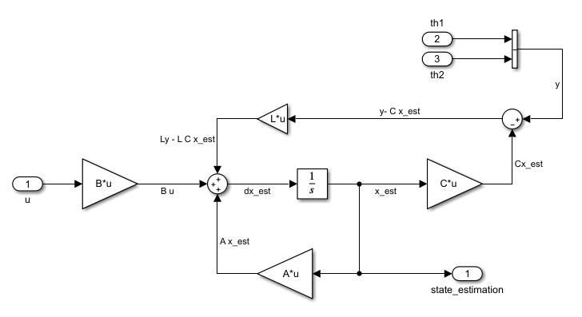
LQR Regulator - Luenberg Observer
𝞱₁
𝞱₂
Notes:
TIM

Slide 16
Demo

Slide 17
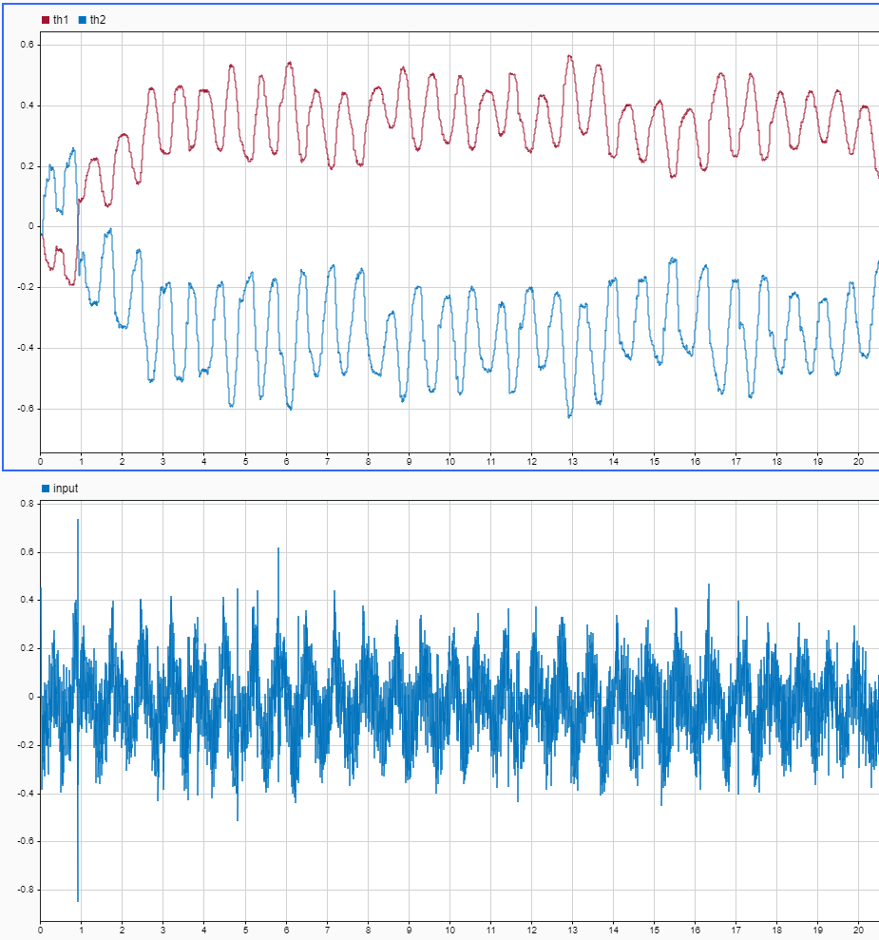
Results and Problems
Objective
Control input
Noisy observer
Non Saturated
Backlash / Friction
Small Oscillations
Steady State Error
Notes:
Matteo
Since position unstable, backlash is a unmodelled dynamic that induces oscillations

Slide 18
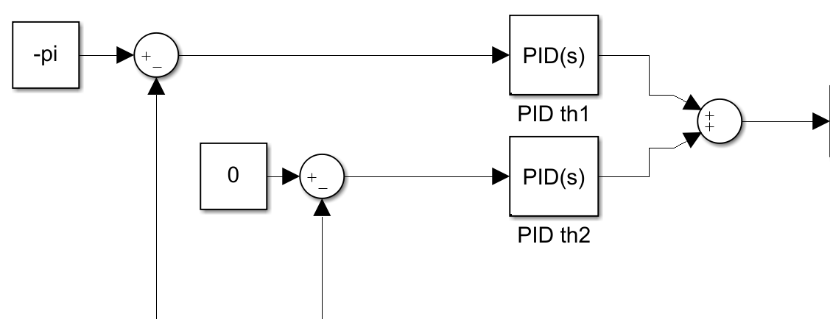
Linear Control - PID Controller
Motivation w.r.t Objective
Tune response to disturbance
Derivative control w/o observer
Layout Motivation
Avoid unwanted stable equilibriums
Problems
Many parameters
Long settling time
u
𝞱₁
𝞱₂
Notes:
Why PID
Why LAYOUT
PROBLEMS

Slide 19
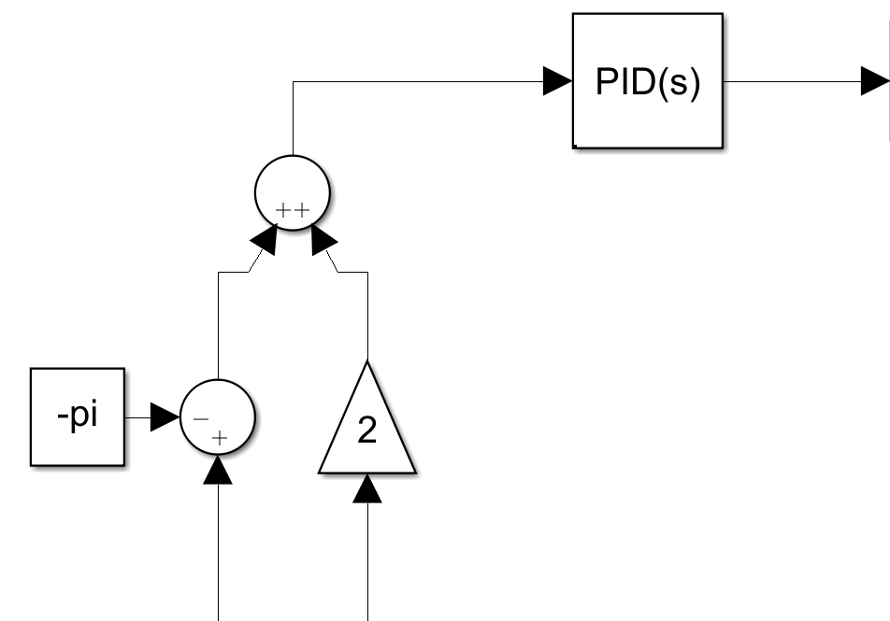
Linear Control - Improved PID Controller
Improvement
Single controller
Less parameters
Faster Settling time
Layout Motivation
Avoid unwanted stable points
𝞱₁
𝞱₂

Slide 20
Demo

Slide 21
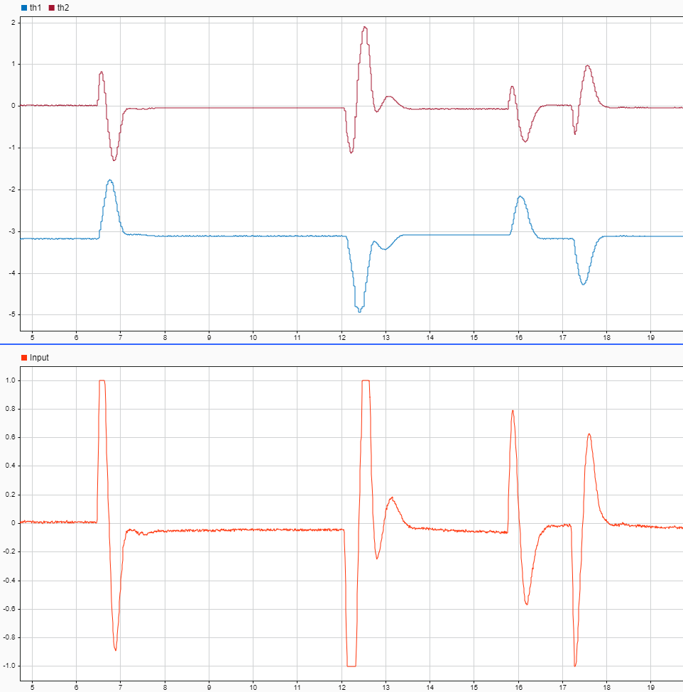
Results and Problems
Objective
Fast Settling
Low Overshoot
Stability and backlash
Control input
Saturates
Wind up
Notes:
Where in LQR backlash induces oscillations, here since the position is stable by default, the backlash has no effect

Slide 22
Questions?

